Slide 1
A Demonstration of Text Input and Validation With Android Compose

Slide 2
DESCRIPTION
State Management :
Text: Holds the current user input in the Outlined Text Field.
is Error: Tracks if the current input meets the validation requirements (in this case, a minimum length of 5 characters).
Text Field Setup:
Validation Logic: As the user types, the on Value Change callback updates text and checks if the input length is at least 5 characters. If not, is Error is set to true, which triggers the error styling and message.
Dynamic Styling: The Text Field Defaults outlined Text Field Colors allows customizing the text field’s border color to show red when there's an error and blue or gray otherwise.
Error Message:
When is Error is true, an error message appears below the text field to inform the user that "Input must be at least 5 characters long.“
Submit Button :
A button labeled "Submit" is provided. It is only enabled when is Error is false, ensuring that the user cannot submit invalid input.
Preview Function:
Preview Text Input With Validation: This @Preview annotated function allows you to preview the composable in Android Studio’s preview pane, making it easier to visualize without running the app.

Slide 3
Main Activity.java:
package com.example.surveyapplication
import android.content.Context
import android.content.Intent
import android.os.Bundle
import androidx.activity.ComponentActivity
import androidx.activity.compose.setContent
import androidx.compose.foundation.Image
import androidx.compose.foundation.background
import androidx.compose.foundation.layout.*
import androidx.compose.material.*
import androidx.compose.runtime.*
import androidx.compose.ui.Alignment
import androidx.compose.ui.Modifier
import androidx.compose.ui.graphics.Color
import androidx.compose.ui.layout.ContentScale
import androidx.compose.ui.res.painterResource
import androidx.compose.ui.text.font.FontFamily
import androidx.compose.ui.text.font.FontWeight

Slide 4
import androidx.compose.ui.text.input.PasswordVisualTransformation
import androidx.compose.ui.tooling.preview.Preview
import androidx.compose.ui.unit.dp
import androidx.compose.ui.unit.sp
import androidx.core.content.ContextCompat
import com.example.surveyapplication.ui.theme.SurveyApplicationTheme
class RegisterActivity : ComponentActivity() {
private lateinit var databaseHelper: UserDatabaseHelper
override fun onCreate(savedInstanceState: Bundle?) {
super.onCreate(savedInstanceState)
databaseHelper = UserDatabaseHelper(this)
setContent {
RegistrationScreen(this,databaseHelper)

Slide 5
}
}
}
@Composable
fun RegistrationScreen(context: Context, databaseHelper: UserDatabaseHelper) {
var username by remember { mutableStateOf("") }
var password by remember { mutableStateOf("") }
var email by remember { mutableStateOf("") }
var error by remember { mutableStateOf("") }
Column(
modifier = Modifier.fillMaxSize().background(Color.White),
horizontalAlignment = Alignment.CenterHorizontally,
verticalArrangement = Arrangement.Center
) {

Slide 6
Image(painterResource(id = R.drawable.survey_signup), contentDescription = "")
Text(
fontSize = 36.sp,
fontWeight = FontWeight.ExtraBold,
fontFamily = FontFamily.Cursive,
color = Color(0xFF25b897),
text = "Register"
)
Spacer(modifier = Modifier.height(10.dp))
TextField(
value = username,
onValueChange = { username = it },
label = { Text("Username") },
modifier = Modifier
.padding(10.dp)
.width(280.dp)

Slide 7
)
TextField(
value = email,
onValueChange = { email = it },
label = { Text("Email") },
modifier = Modifier
.padding(10.dp)
.width(280.dp)
)
TextField(
value = password,
onValueChange = { password = it },
label = { Text("Password") },
visualTransformation = PasswordVisualTransformation(),
modifier = Modifier
.padding(10.dp)
.width(280.dp)
)

Slide 8
if (error.isNotEmpty()) {
Text(
text = error,
color = MaterialTheme.colors.error,
modifier = Modifier.padding(vertical = 16.dp)
)
}
Button(
onClick = {
if (username.isNotEmpty() && password.isNotEmpty() && email.isNotEmpty()) {
val user = User(
id = null,
firstName = username,

Slide 9
lastName = null,
email = email,
password = password
)
databaseHelper.insertUser(user)
error = "User registered successfully"
// Start LoginActivity using the current context
context.startActivity(
Intent(
context,
LoginActivity::class.java
)
)
} else {
error = "Please fill all fields"
}
},

Slide 10
colors = ButtonDefaults.buttonColors(backgroundColor = Color(0xFF84adb8)),
modifier = Modifier.padding(top = 16.dp),
) {
Text(text = "Register")
}
Spacer(modifier = Modifier.width(10.dp))
Spacer(modifier = Modifier.height(10.dp))
Row() {
Text(
modifier = Modifier.padding(top = 14.dp), text = "Have an account?"
)
TextButton(onClick = {
context.startActivity(
Intent(
context,
LoginActivity::class.java
)
)
})

Slide 11
{
Spacer(modifier = Modifier.width(10.dp))
Text( color = Color(0xFF25b897),text = "Log in")
}
}
}
}
private fun startLoginActivity(context: Context) {
val intent = Intent(context, LoginActivity::class.java)
ContextCompat.startActivity(context, intent, null)
}

Slide 12
OUTPUT:

Slide 14
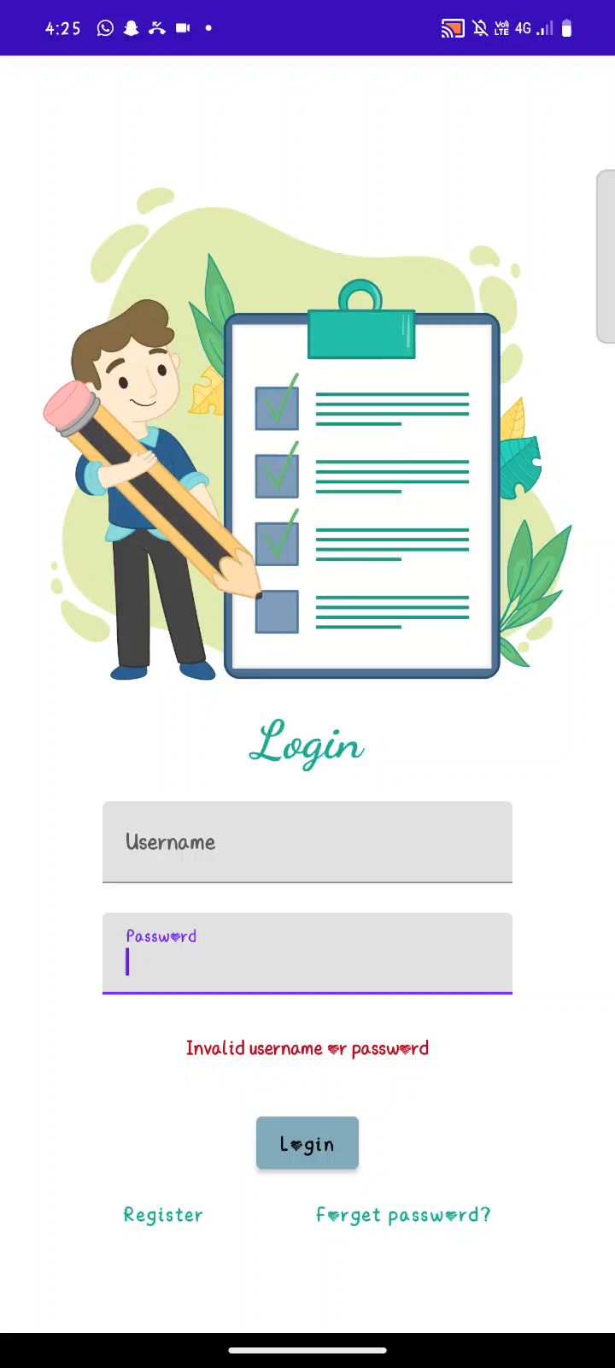
Output

